Slide 1
Java Programming
Write once, run anywhere

Slide 2
Content of The Day
Module 1 : Java Fundamentals | 1- Introduction to Java 2- Variables and Data Types 3- Control Statements (Conditions and Loops) 3- Functions and Methods

Slide 3
01
Java Fundamentals
Building Blocks for Java Development

Slide 4
Introduction
Java is a popular and versatile object-oriented programming language known for its platform independence, allowing code to be written once and run on any compatible platform.
It offers a strong focus on code reusability and modularity through object-oriented principles, making it suitable for a wide range of applications. With its widespread adoption, extensive libraries, and active community support,

Slide 5
Java Basics
Welcome to Java Basics!
What is Java?
Why Learn Java?

Slide 6
Java Basics
Java Overview:
Platform Independence
Java Virtual Machine (JVM)
"Write Once, Run Anywhere" Concept

Slide 7
Java Basics
Setting Up Java:
Downloading and Installing JDK (Java Development Kit)
Setting Environment Variables

Slide 8
Java Basics
Getting Started with Java:
Writing Your First Java Program
Compiling and Running Java Code
Exploring the Main Method

Slide 9
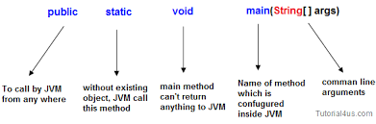
Main Method
"Don't be confused; it's easy! The main method will be discussed Later.
You only need to know that this method is for running your code.
If you want anything to be executed, put it inside main."

Slide 10
Java Basics
Variables and Data Types:
Declaring Variables
Primitive Data Types (int, double, char, boolean)
Reference Data Types (String)

Slide 11
Simple data types
Type | Size in memory | Example
Byte | 8-bit | byte age = 25;
Short | 16-bit | short temperature = -10;
Int | 32-bit | int population = 1000000;
Long | 64-bit | long distance =1000000000L;
Float | 32-bit | float pi = 3.14f;
Double | 64-bit | double salary = 5000.50;
Char | 16 bit | char grade = 'A';
Boolean | 8-bit | boolean isActive = true;

Slide 12
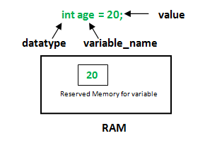
How to create a variable

Slide 13
Java Basics
Control Structures:
Conditional Statements (if-else, switch)
Loops (for, while, do-while)
Break and Continue Statements

Slide 14
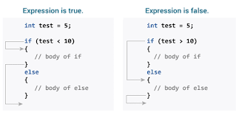
If .. else statement

Slide 15
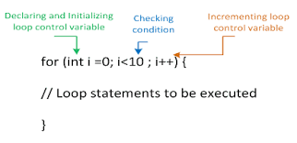
For Loop

Slide 16
Java Basics
Functions and Methods:
Defining and Calling Methods
Parameters and Return Values
Method Overloading

Slide 17
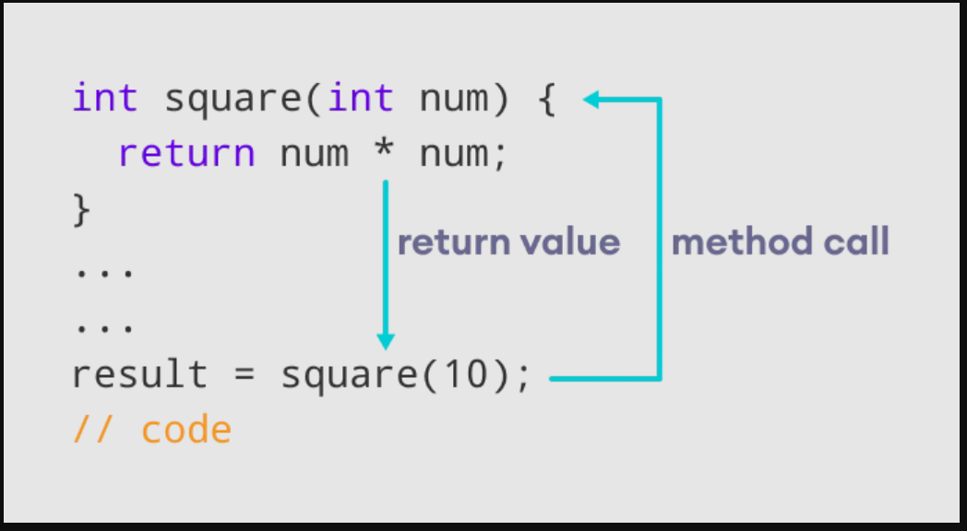
Methods

Slide 18
Tasks
Think then solve
What is platform independence
Declare variables of different data types (int, double, char, boolean) and use them in various control structures (if-else, switch, loops).
create methods for basic arithmetic operations like addition, subtraction, multiplication, and division.

Slide 19
—Someone Famous
"Learning to program is like learning a new language; embrace the fundamentals, and the possibilities will become endless."

Slide 20
Thanks!
Do you have any questions?
amerosama.jr@gmail.com
01007698027

